Slide 1
Stroke Prediction
11 clinical features for predicting stroke events

Slide 2
Context
According to the World Health Organization (WHO) stroke is the 2nd leading cause of death globally, responsible for approximately 11% of total deaths.

Slide 3
This dataset is used to predict whether a patient is likely to get stroke based on the input parameters like gender, age, various diseases, and smoking status.
Each row in the data provides relevant information about the patient.

Slide 4
Attribute Information
1) id: unique identifier
2) gender: "Male", "Female" or "Other"
3) age: age of the patient
4) hypertension: 0 if the patient doesn't have hypertension, 1 if the patient has hypertension
5) heart_disease: 0 if the patient doesn't have any heart diseases, 1 if the patient has a heart disease
6) ever_married: "No" or "Yes"

Slide 5
7) work_type: "children", "Govt_jov", "Never_worked", "Private" or "Self-employed"
8) Residence_type: "Rural" or "Urban"
9) avg_glucose_level: average glucose level in blood
10) bmi: body mass index
11) smoking_status: "formerly smoked", "never smoked", "smokes" or "Unknown"*
12) stroke: 1 if the patient had a stroke or 0 if not
*Note: "Unknown" in smoking_status means that the information is unavailable for this patient

Slide 6
Approaches
Preprocessing Data before Exploratory Data Analysis
Exploratory Data Analysis on Stroke Prediction Data
Preparing the Data for Prediction
Creating a Model for Stroke Prediction

Slide 7
Preprocessing Data before Exploratory Data Analysis
Using round() to round off Age.
Setting values to NaN where BMI is less than 12 and greater than 60 as these can be considered as outliers.
Sorting the Data Frame first based on Gender then on Age and using Forward Filling to fill those missing BMI values.

Slide 8
Exploratory Data Analysis
Checking if the Data is Balanced.
Plotting various graphs to check relation between the each column with respect to stroke.
Age vs BMI with Stroke
BMI vs Avg Glucose Level
Percentage of people who got stroked in each category

Slide 9
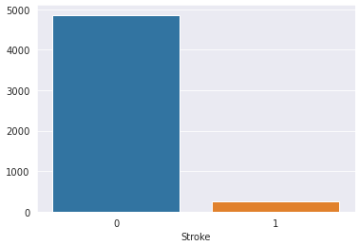
Beside plot shows that the Data is not
balanced which will result in a bad
Model.
So a balancing technique called SMOTE has
been used to balance the Data.
This was done before fitting our data to the model.

Slide 10
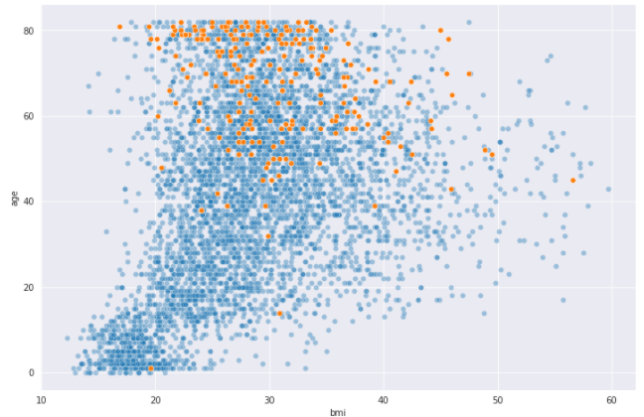
Age vs BMI plot

Slide 11
From the above Age vs BMI plot we saw that when people attain an age of 40 or greater the chances of getting a stroke increases and after 60+ it tends to increase even more. Also, people with a BMI of 25+ have shown a higher chances of encountering a stroke.
So, people with 40+ years and BMI of 25+ have a greater probability of encountering a stroke.

Slide 12
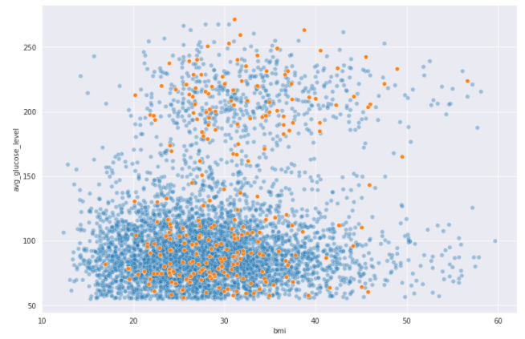
Avg Glucose Level vs BMI plot

Slide 13
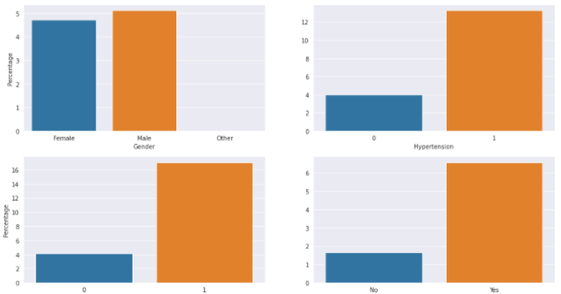
Plot of % of Stroke in each category

Slide 14
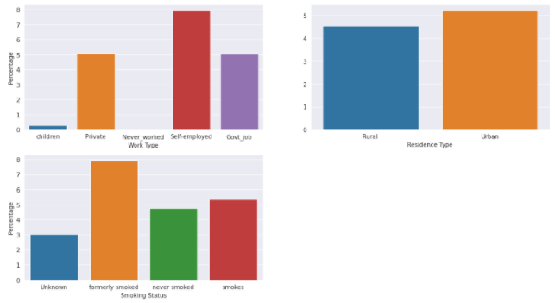

Slide 15
Conclusions drawn from the above plot with respect to the Stroke Data
Both the Genders have around 5% chance.
People with history of Hypertension and Heart Disease have shown an increase in percentage of Stroke with around 12.5% and 16.5% respectively.
Married/Divorced people have a 6.5% chance of stroke. No wonder why people these days choose to stay single.

Slide 16
Self Employed people have a higher chance compared to Private and Govt Jobs.
Rural and Urban doesn't show much difference.
For some reason people who once used to smoke have higher chance compared to people who are still smoking. If you have already started smoking, don't stop. JK, do as you wish.

Slide 17
Preparing the Data for the Prediction
Converting the Categorical Columns into Numerical by Mapping each category to an integer value using map() on pandas series object.
Using a balancing technique called SMOTE (Synthetic Minority Oversampling Technique) to balance the data if unbalanced.
Splitting the Data in Training and Testing Samples

Slide 18
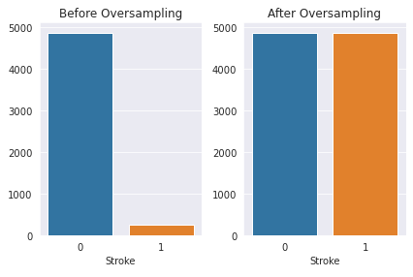
Bar plots before and after balancing the unbalanced data

Slide 19
Finally we created a Model for the Prediction

